Slide 1

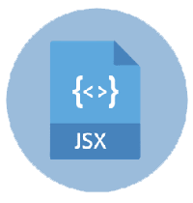

Slide 2
About today…
React.js
Intro
JSX

Slide 3

INTRO

Slide 4
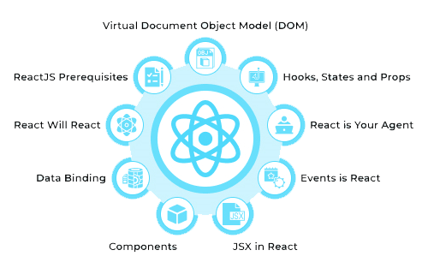
Understanding React
Definition
React is a JavaScript library for building user interfaces
Creator
Developed by Facebook
Initial Release
March 2013
Key Feature
Enables the creation of reusable UI components

Slide 5

Why Use React?
Component-Based Architecture
Reusable and independent pieces of UI
Virtual DOM
Efficient rendering and updating of components
Declarative
Makes it easy to design interactive UIs
Ecosystem and Community
Extensive tools, libraries, and a large community

Slide 6
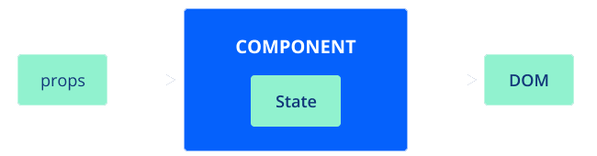
React Core Concepts
Components
The building blocks of a React application
Functional components
Class components
State and Props
Managing dynamic data in components
Lifecycle Methods
Hooks into different stages of a component's life

Slide 7

What is JSX?
Definition
JSX stands for JavaScript XML
Purpose
A syntax extension for JavaScript, used to describe what the UI should look like
Integration
Allows embedding HTML within JavaScript code

Slide 8

JSX Syntax
Embedding Expressions
Using curly braces to embed JavaScript expressions in JSX
Attributes
Similar to HTML, with some differences (e.g., className instead of class)
Self-Closing Tags
For elements without children

Slide 9
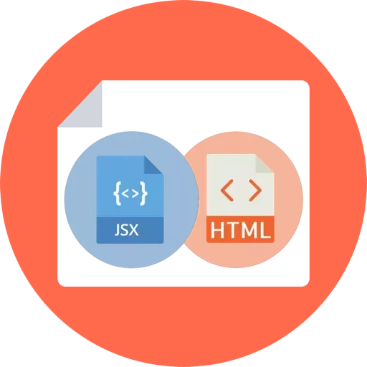
JSX vs HTML
Case Sensitivity
JSX is case-sensitive, while HTML is not
Attributes
JSX attributes are camelCase
Fragments
Using <> and </> for grouping multiple elements

Slide 10


Slide 11

What is React?
Who developed React?
What is one of the key features of React?
What is the Virtual DOM in React?
What are the building blocks of a React application?
What is the primary purpose of JSX?

Slide 12

Task 1
Create a button that changes its color when clicked
Task 2
Implement form validation using event listeners

